Slide 1
Methods of Fraud Detection in Mobile Transactions: Gradient Boosting and Isolation Forest
Matei Sonia

Slide 2
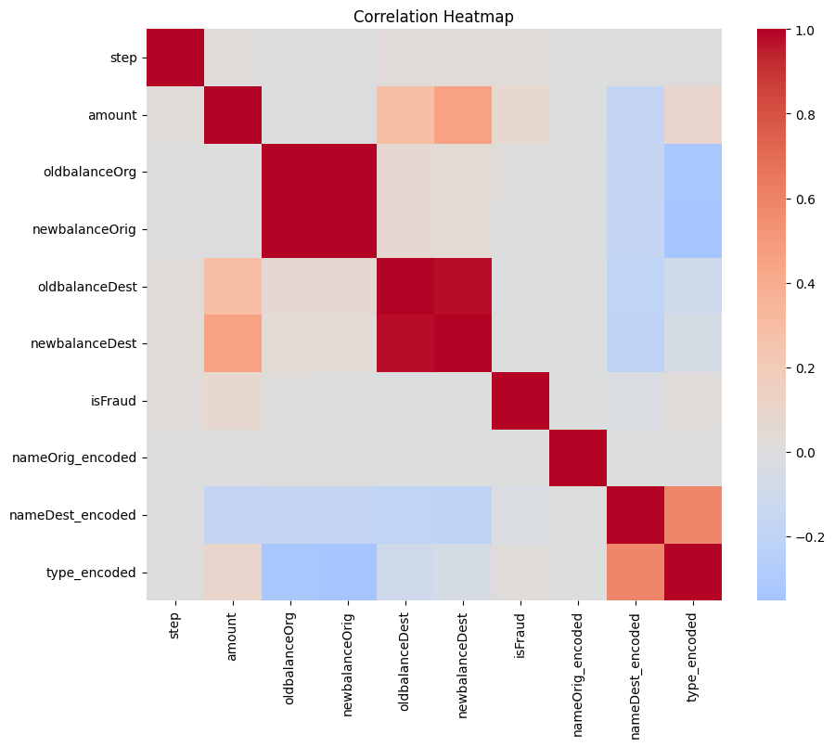
Synthetic Financial Mobile Money Transactions Dataset (PaySym Dataset)
Simulates mobile money transactions
6 million records
features:
Transaction type
Amount
Time information
Origin and destination account balances
The balance of account before and after transactions (information leakage)
Indicator of whether a transaction is fraudulent

Slide 3
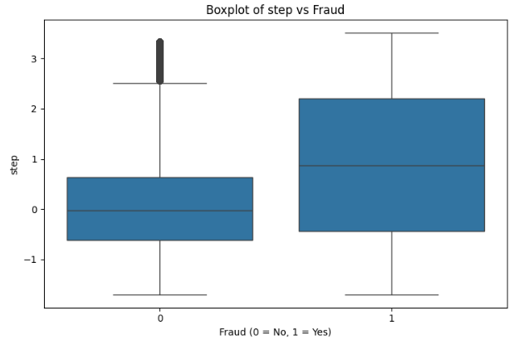
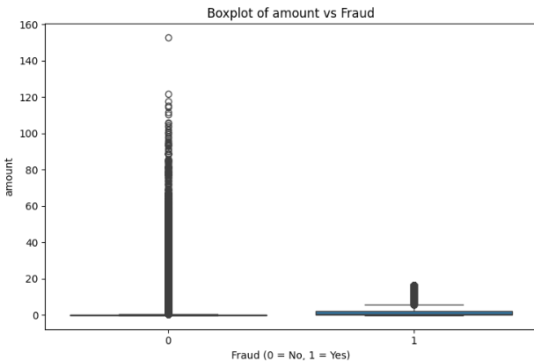
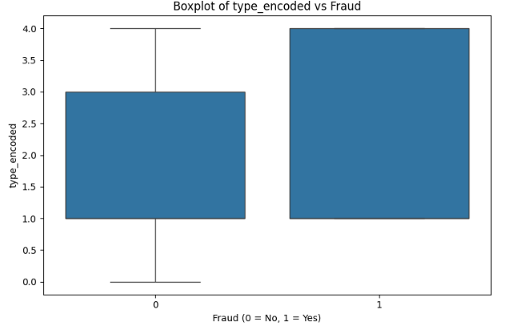
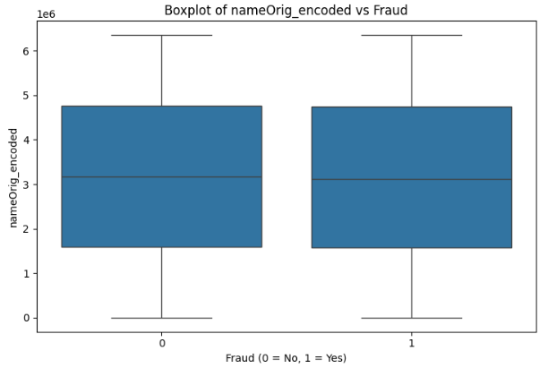
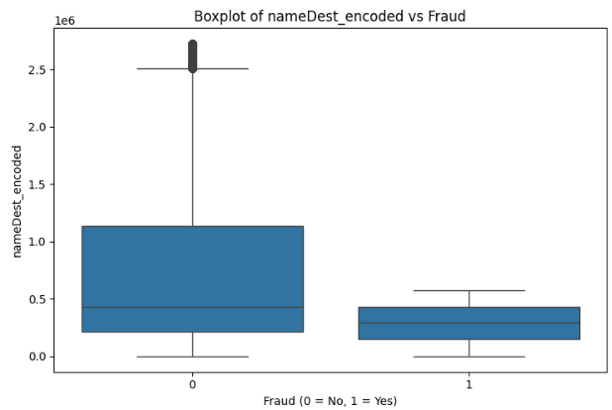
Boxplots
Fraudulent transactions can occur later in time.
Fraudulent transactions have lower amounts compared to non-fraudulent ones.
Only two types of transactions are fraudulent.
Originating account name does not strongly differentiate fraud from non-fraud.
Fraud is concentrated toward a smaller set of destination accounts

Slide 4
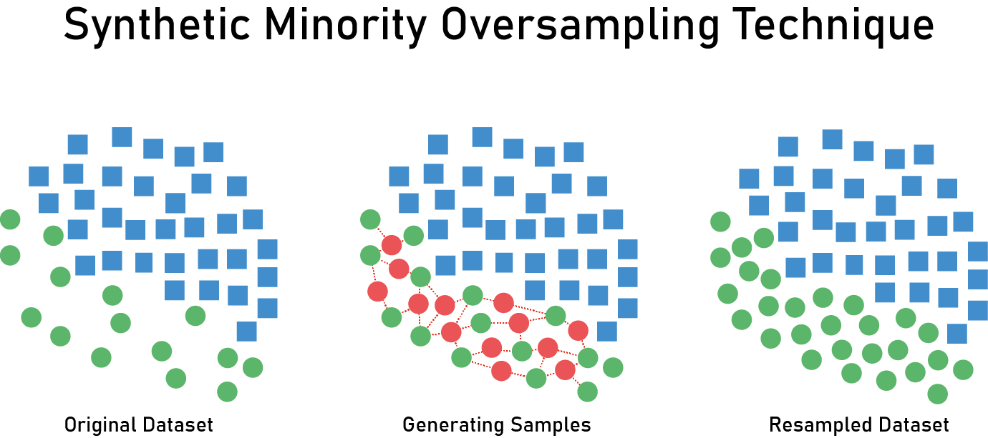
Smote
Original size: 6362620
Original class distribution: [6354407 8213]
Balanced size: 12708814
Balanced class distribution: [6354407 6354407]
Training set fraud distribution:
isFraud
0 5083570
1 5083481
Test set fraud distribution:
isFraud
1 1270926
0 1270837
SMOTE generates new, synthetic examples by creating points that lie between existing minority class samples.

Slide 5
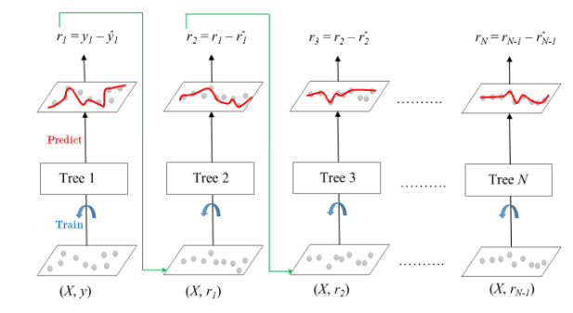
Gradient Boosting
An ensemble of weak learners (usually decision trees) in a sequential manner, where each new tree corrects the errors of the previous ones.

Slide 6
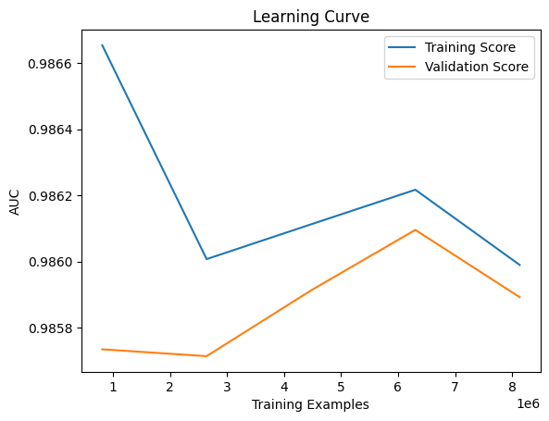
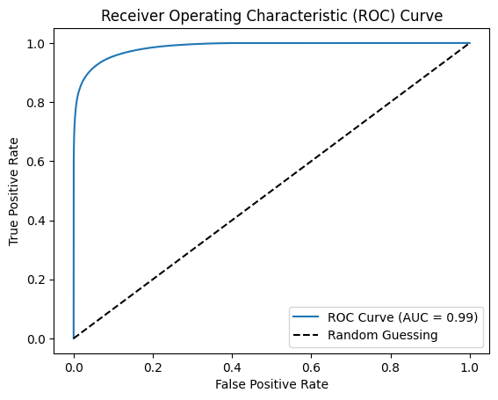
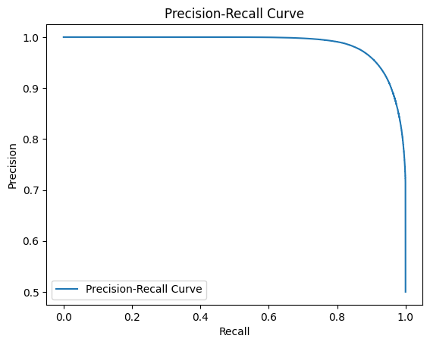
Gradient boosting: PErformance
Training AUC: 0.9859523704861836
Test AUC: 0.985910997563826
The first tasks was predicting the "isFraud" for classifying whether a transaction is fraudulent or not.
precision recall f1-score support
0 0.92 0.94 0.93 1270837
1 0.94 0.92 0.93 1270926
accuracy 0.93 2541763
Reduced gap between training and validation set: reduced overfitting
Validation score increases: better generalization.

Slide 7
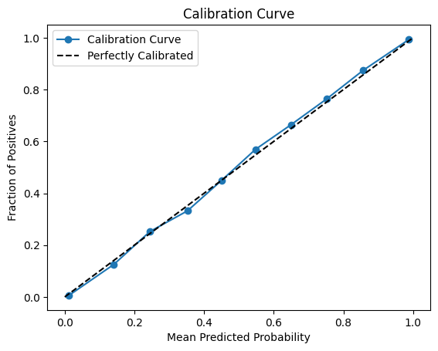
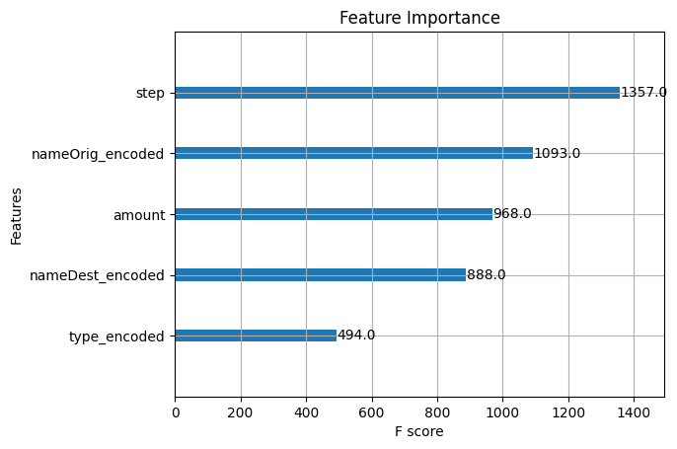
Gradient boosting: PErformance
The model predicts accurate classifications and has reliable confidence scores for those predictions.

Slide 8
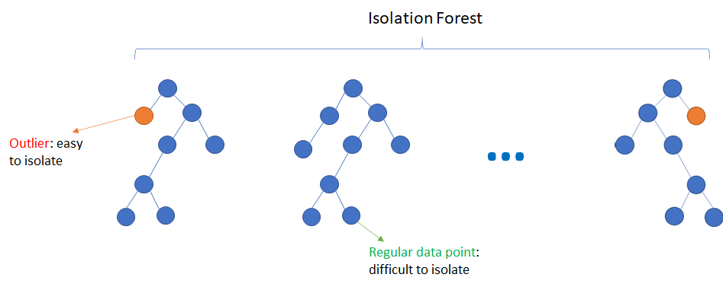
Isolation Forest
In Isolation Forest, the results from all trees are combined by averaging the path lengths for each data point.

Slide 9
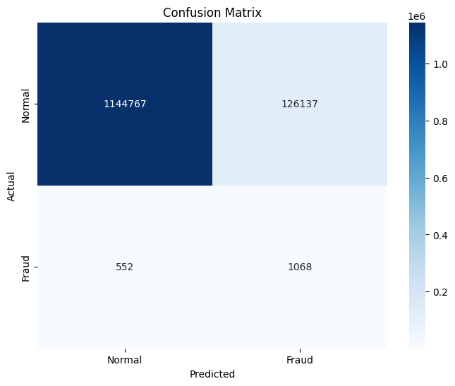
Isolation forest: PErformance
The second task used anomaly detection to identify whether a transaction is fraudulent or not.
precision recall f1-score support
0 1.00 0.90 0.95 1270904
1 0.01 0.66 0.02 1620
accuracy 0.90 1272524
"Normal" class dominates the predictions (low precision, but high recall). Assumes many instances as fraud.

Slide 10
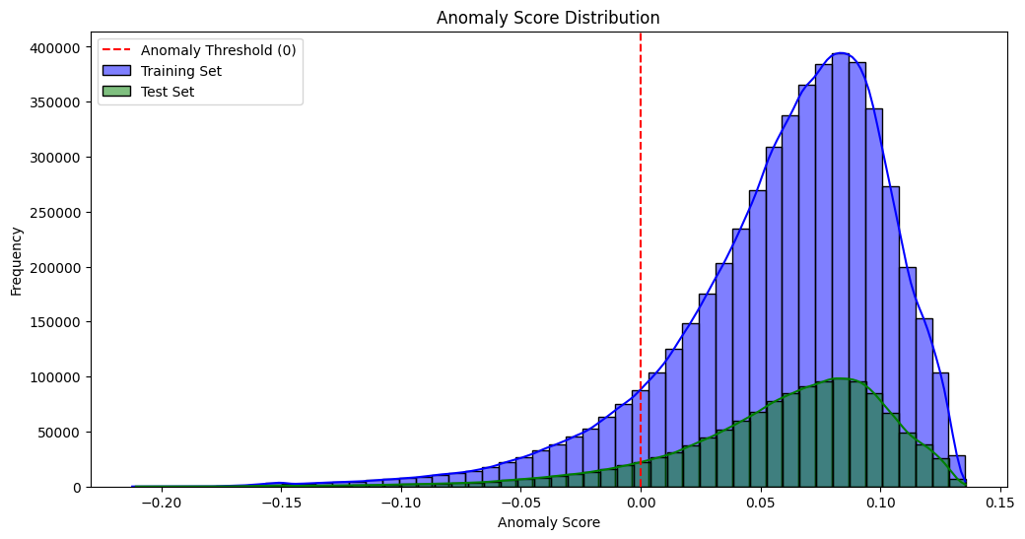
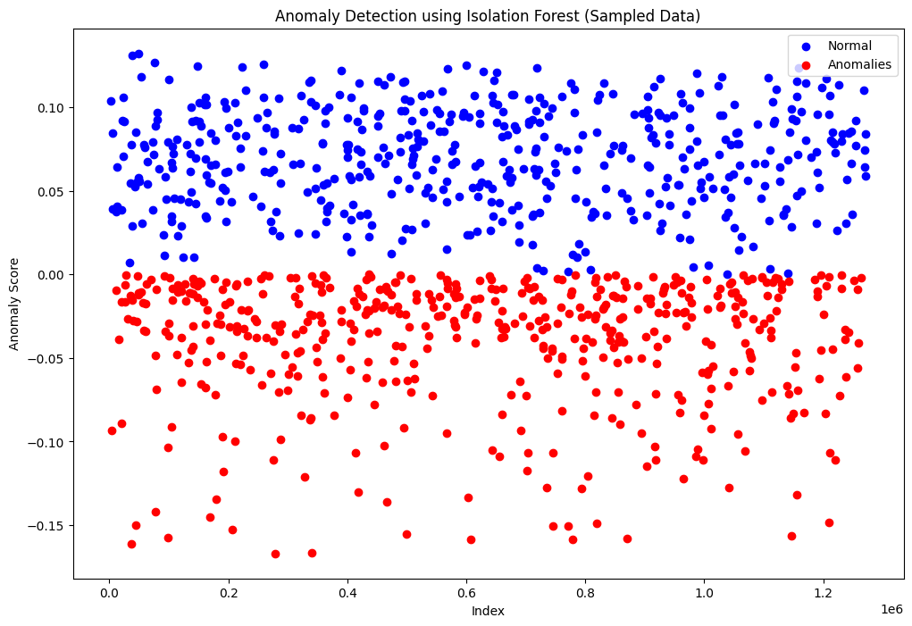
Isolation forest: PErformance
Most data points have positive anomaly scores, indicating they are normal. Same distribution denotes reduced risk of overfitting.
Visualization of the anomaly scores given by the model.

Slide 11
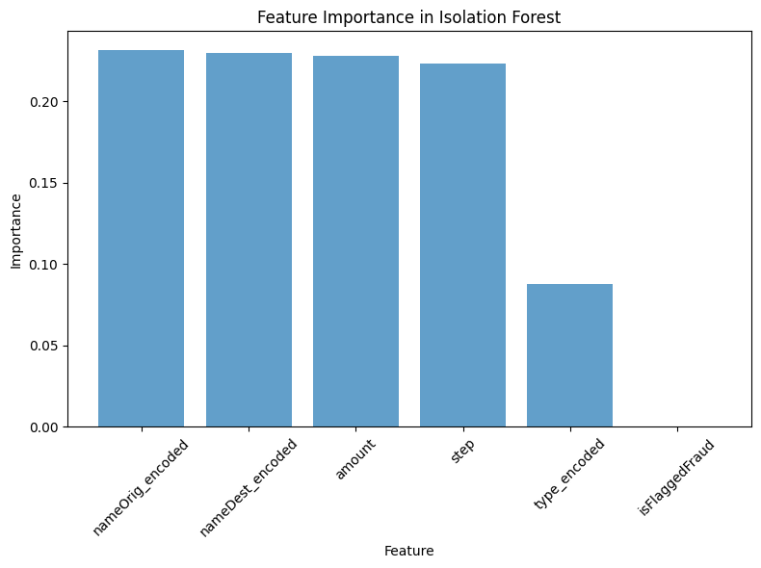
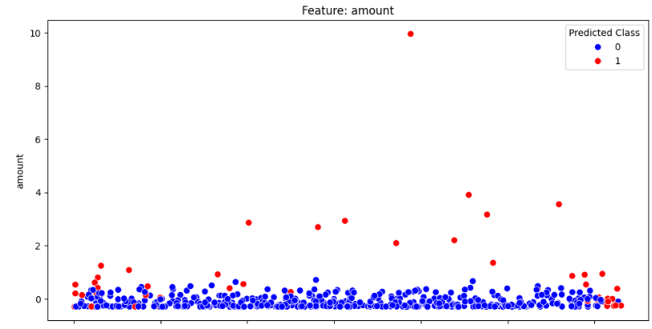
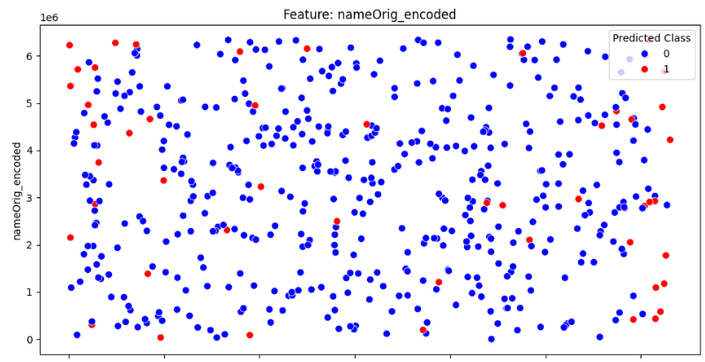
Isolation forest: PErformance
Fraudulent transactions tend to involve larger amounts, but in dataset we establisehed otherwise.
Model doesn't perform well.
Fraudulent and normal transactions appear randomly distributed and give no valuable information, but it is the most important feature for the model.

Slide 12
THANK YOU

